Slide 1

One design decision that can baffle the mind is where should the correct answer go?
Have a correct answer in each specific question class, ie. TrueFalse, ShortAnswer, MultipleChoice…
Have all correct answers stored in the Test class
CS 350 – Software Design – Drexel University

Slide 2
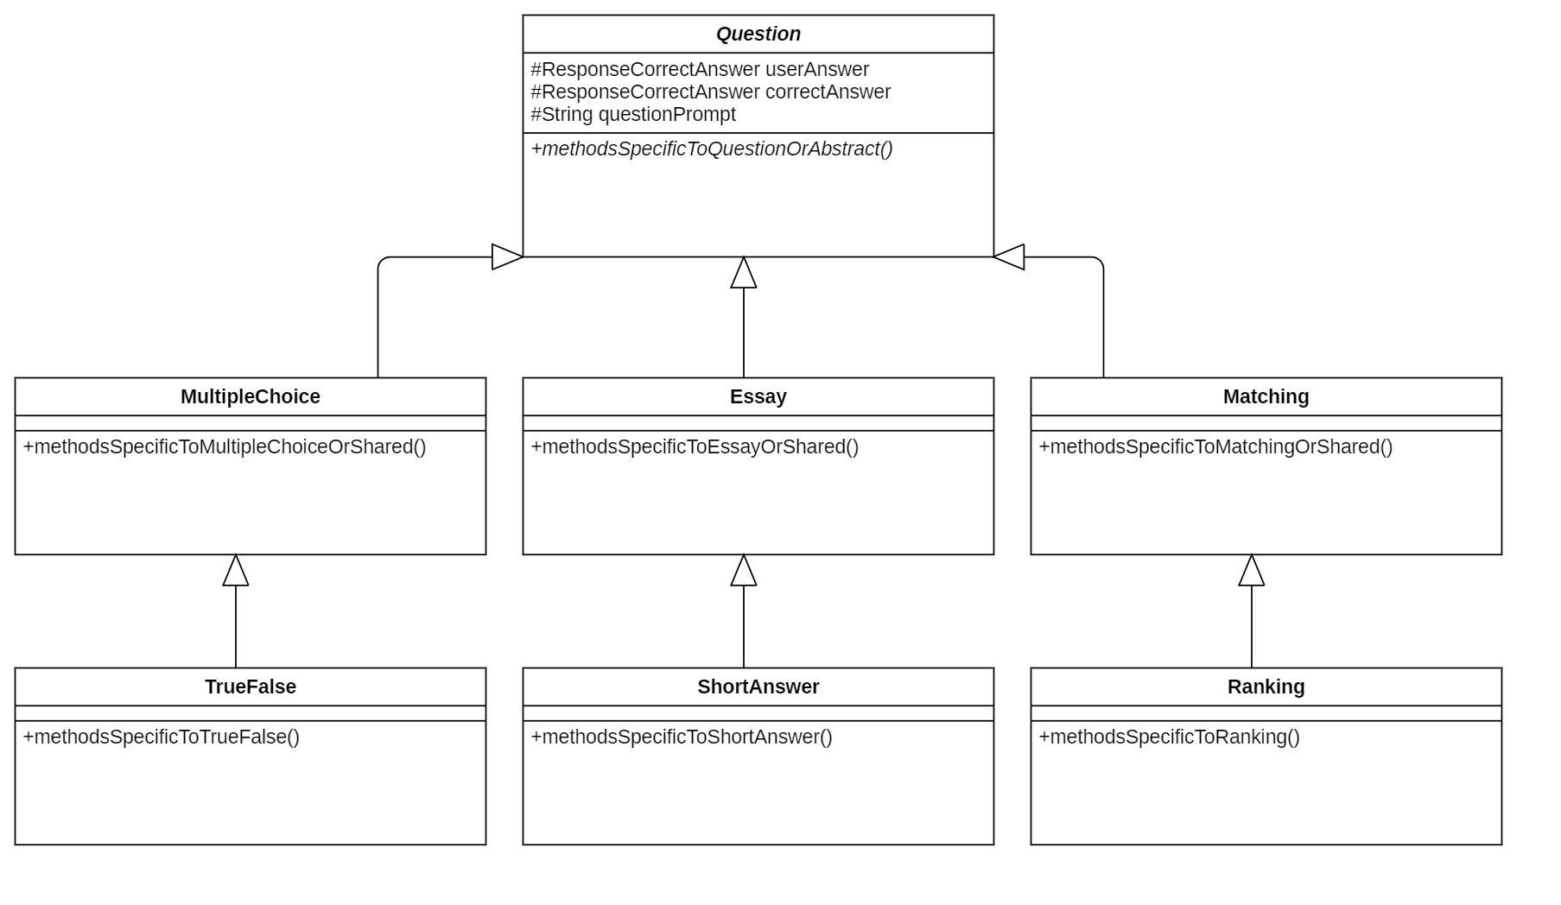
At first the idea of placing a correct answer in each question class has great appeal.
Comparing a response/correct answer is convenient since they are in the same class.
However, what if you just want a survey program?
Now code for test must be included even though it’s not used.
This violates our principles of design.
Return to the previous choice
CS 350 – Software Design – Drexel University

Slide 3
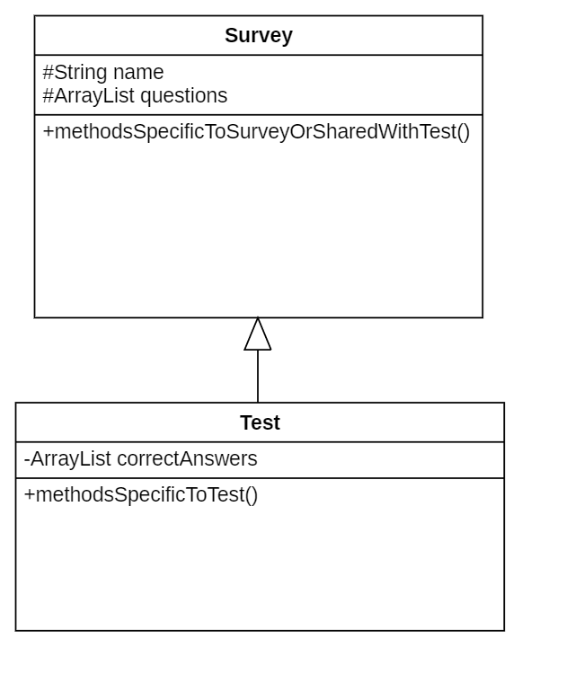
While including the correct answers with the Test class may not seem appropriate, it is more appropriate because correct answers should never be included in a survey program.
CS 350 – Software Design – Drexel University

